Slide 1

Being in the shoes of an online buyer
Pedro, Felix Andrei IV
Teodoro, Emily Grace

Slide 2






Slide 3
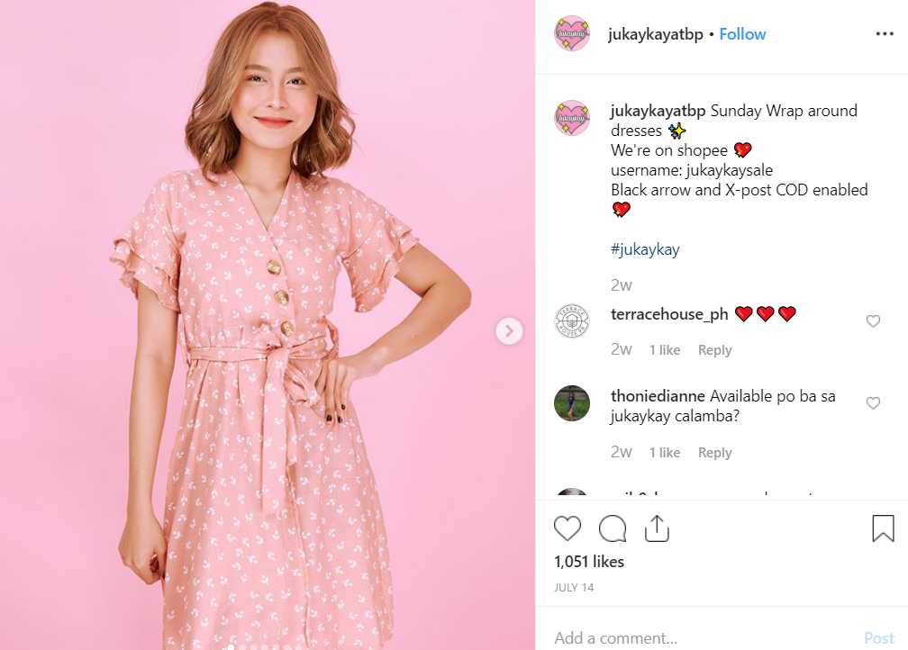



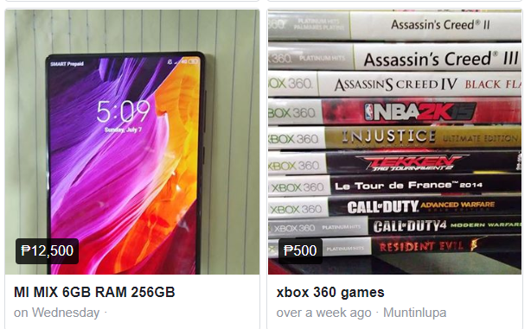

Slide 4
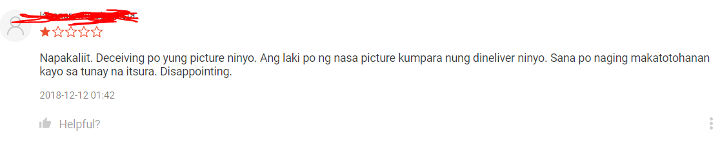
Observation
The items isn’t the same as the picture shown in the online shop.

Slide 5
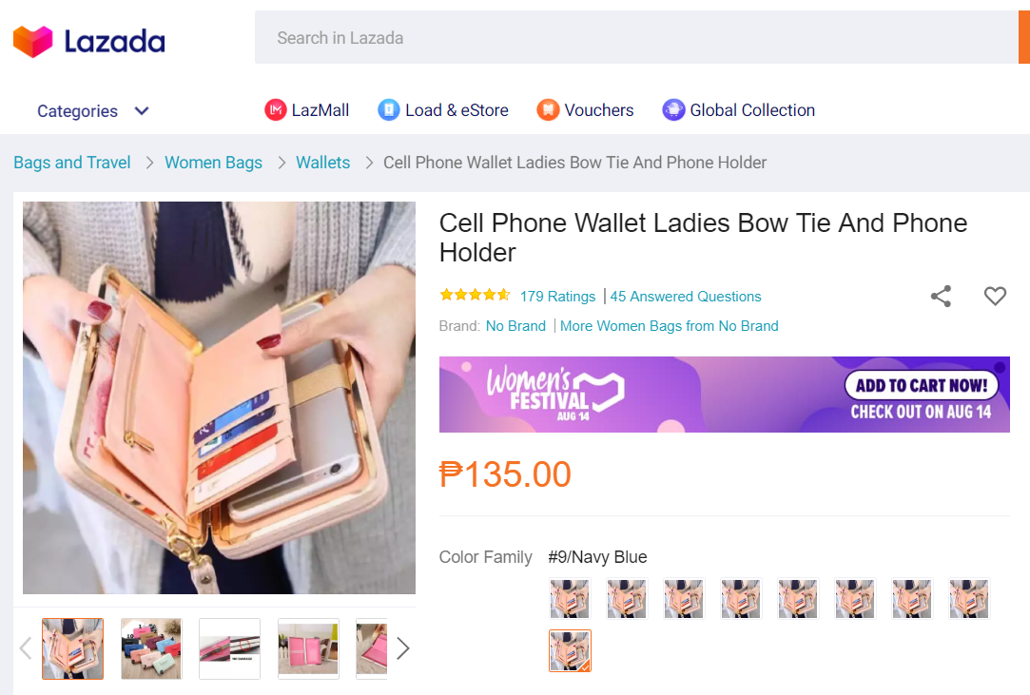
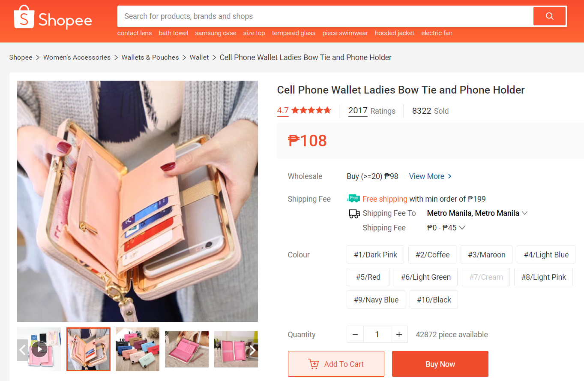
Observation
The buyer would like an app that would help compare prices.

Slide 6
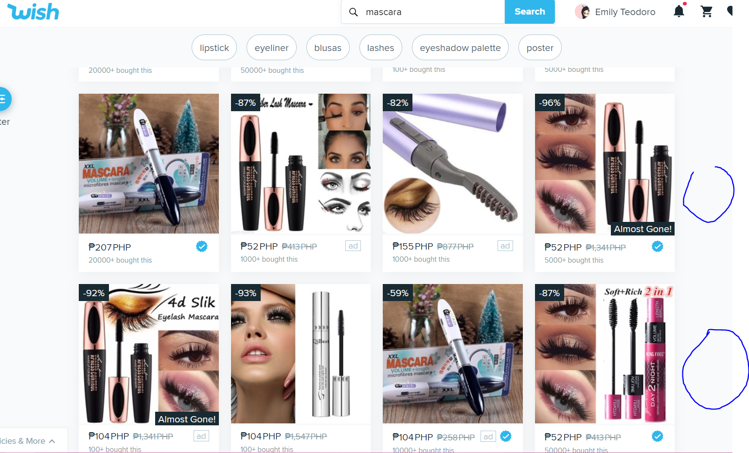
Observation
The items isn’t the same as the picture shown in the online shop.

Slide 7
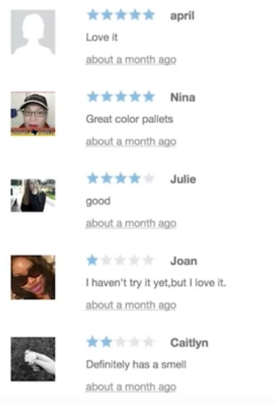
Observation
The reviews on the online shop is forged.

Slide 8
Identification Needs
The buyer needs an application that will be easy to compare prices.
The buyer needs application that will be easy to compare shipping fee.
The buyer needs application that will be easy to compare the online stores ratings and reviews.
The buyer needs a way to use vouchers as an option to save money.

Slide 9
Point of View
With vouchers, you can effectively save more money.
How would you find a certain online without getting scammed?
How could you easily find good deals online?

Slide 10
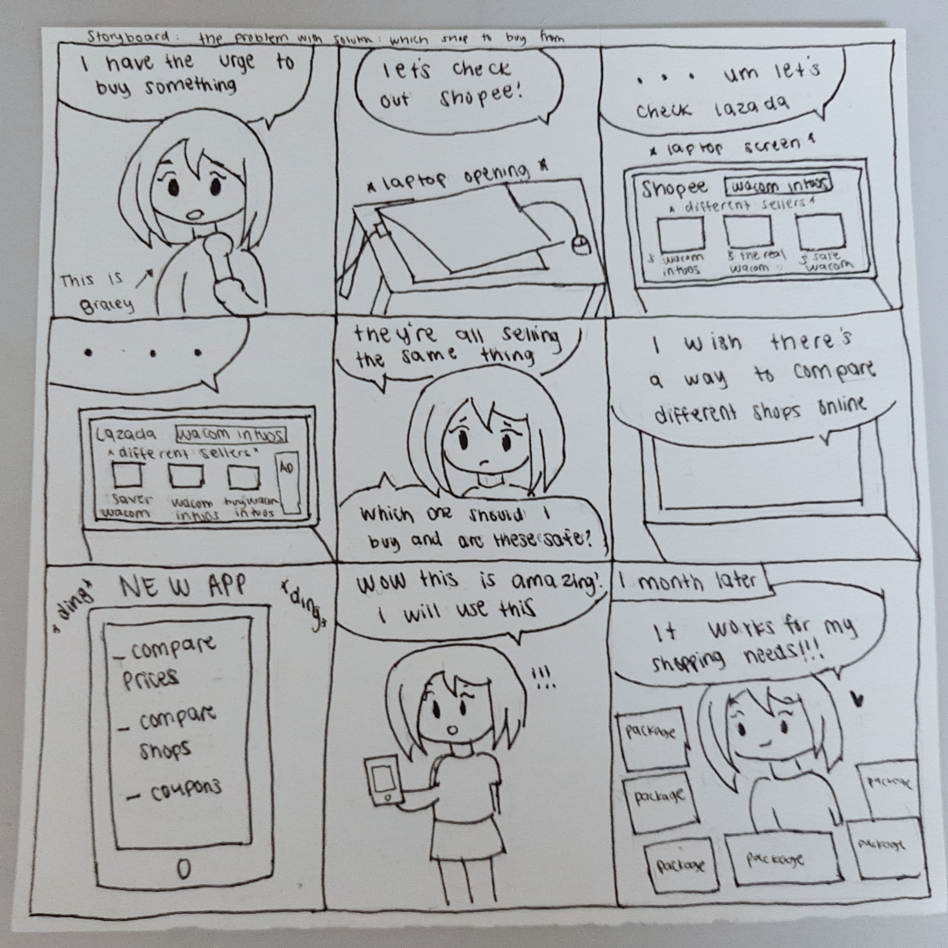
Storyboard 1

Slide 11
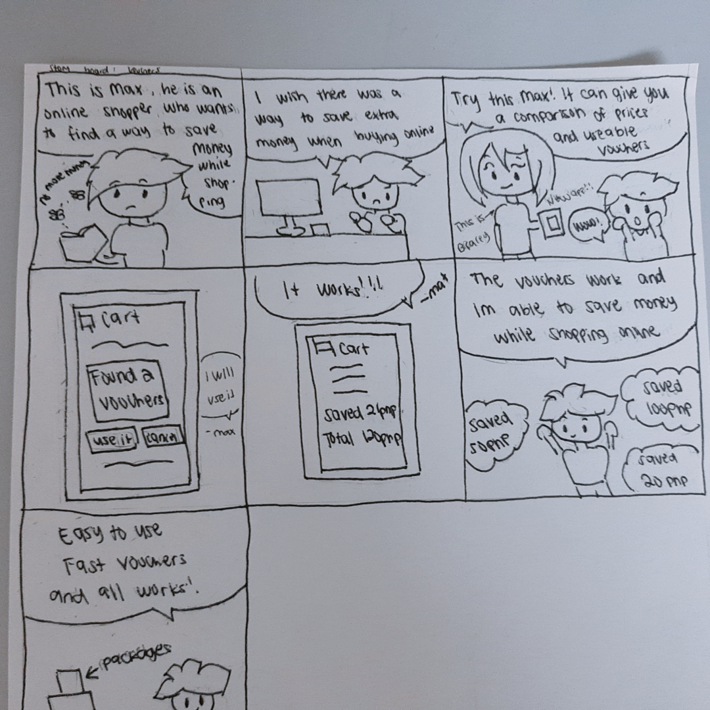
Storyboard 2

Slide 12
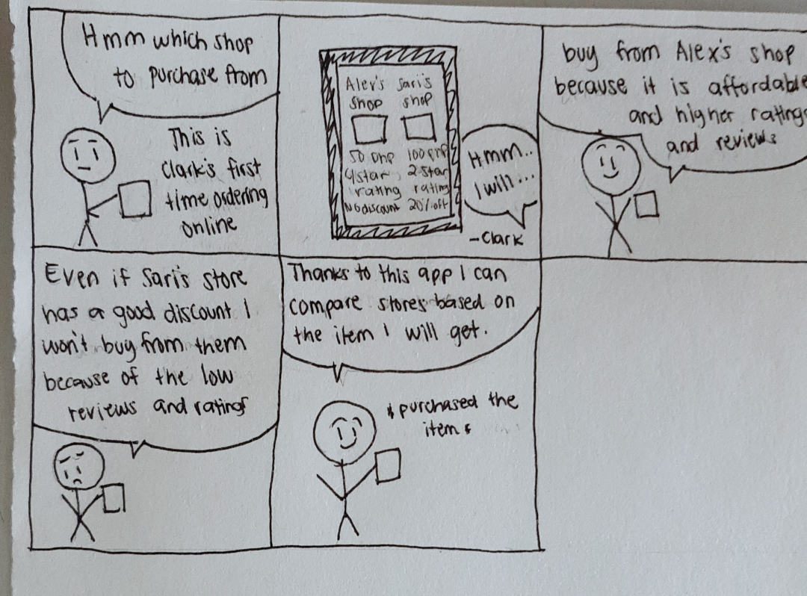
Storyboard 3

Slide 13
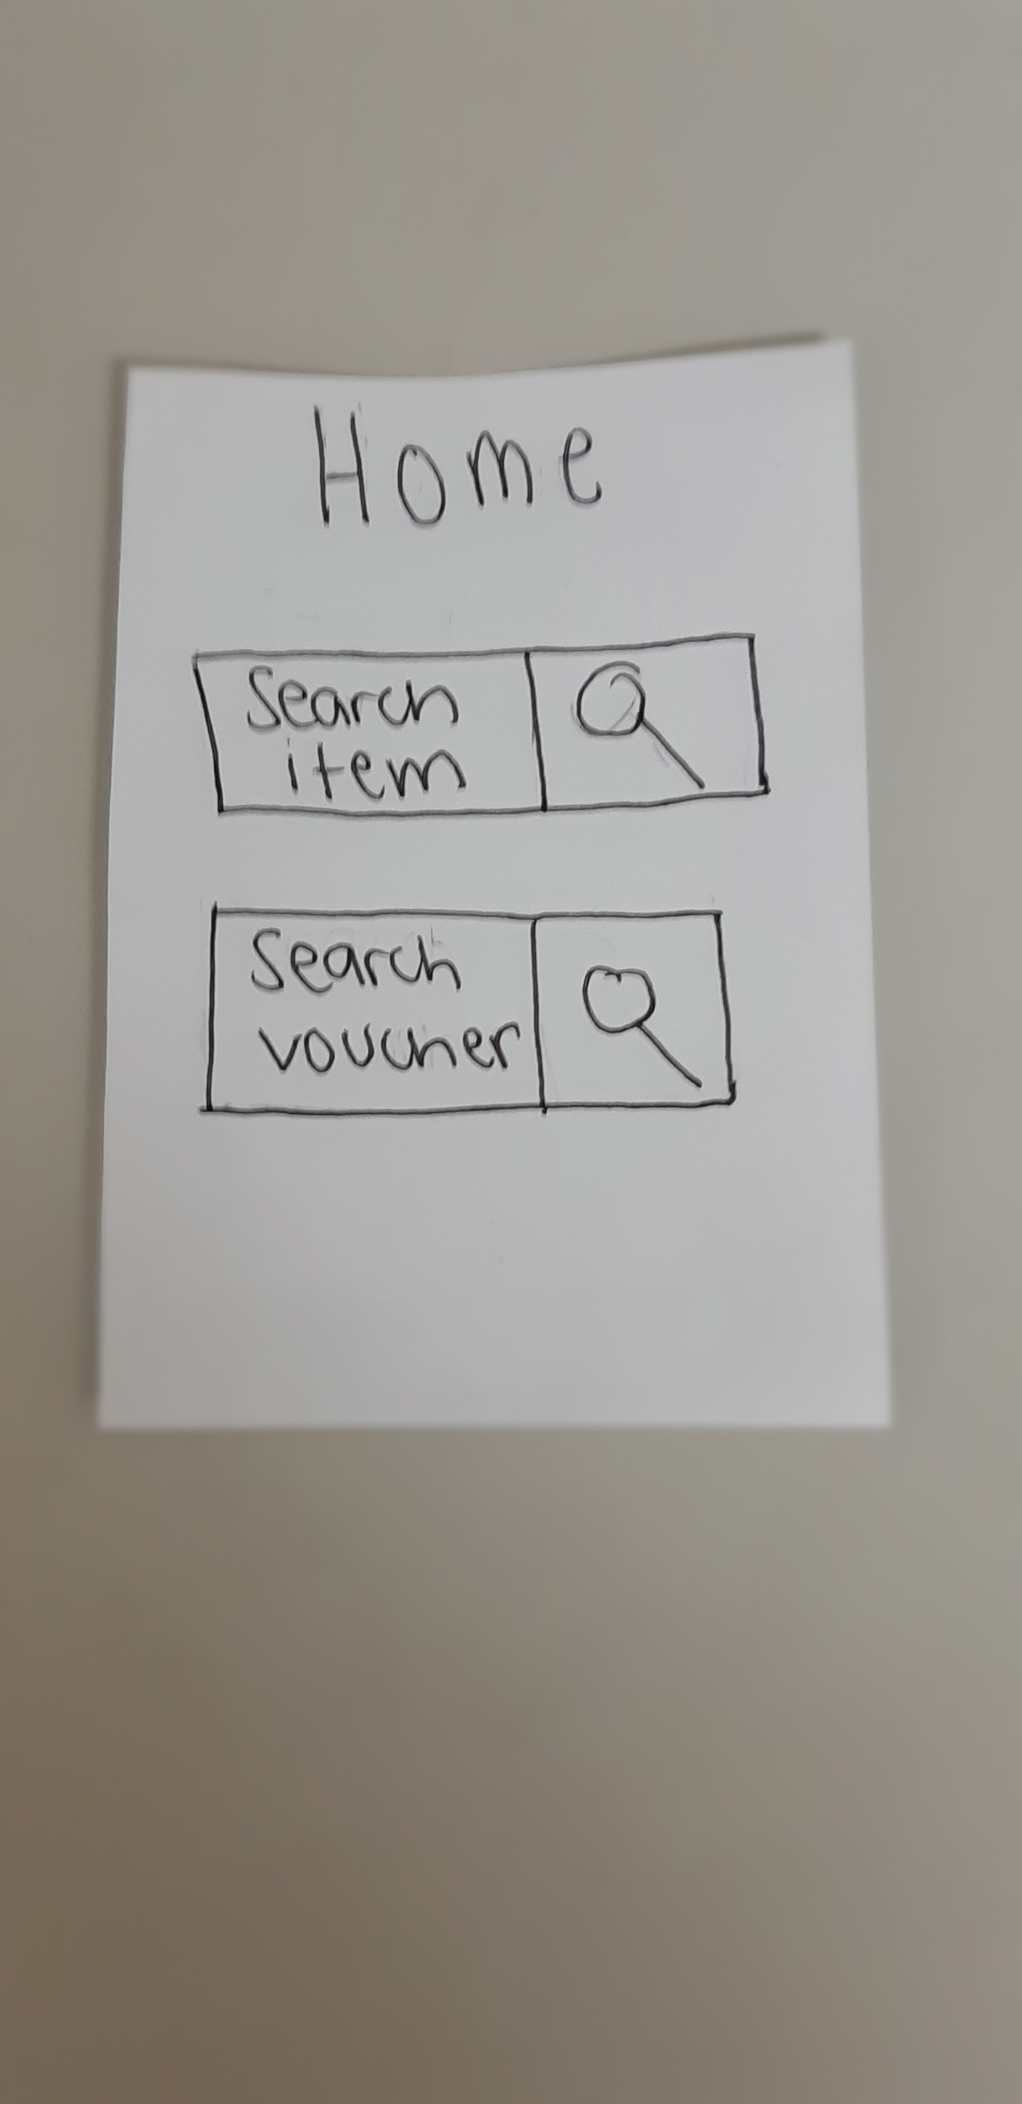
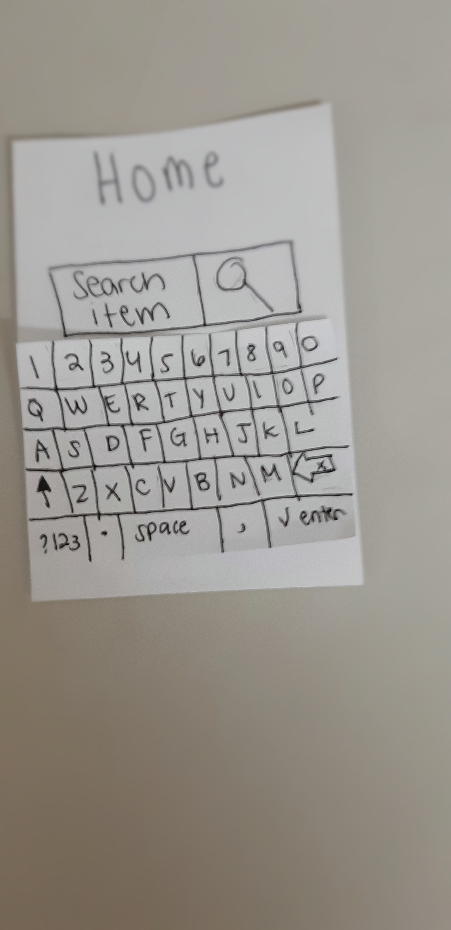
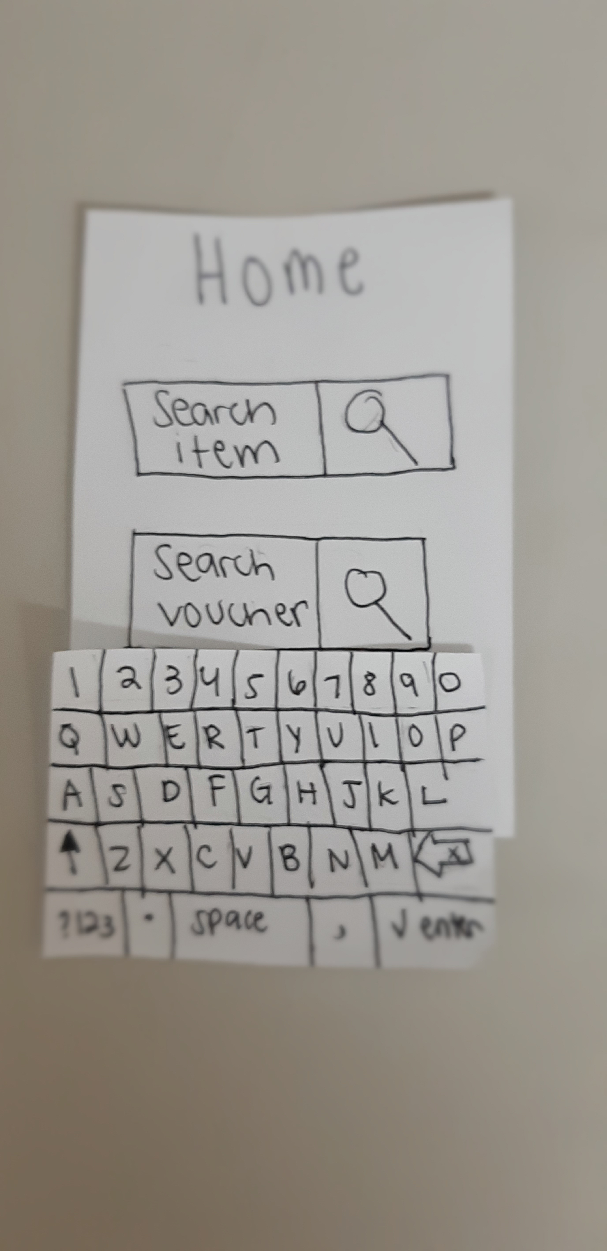
Paper Prototype 1

Slide 14
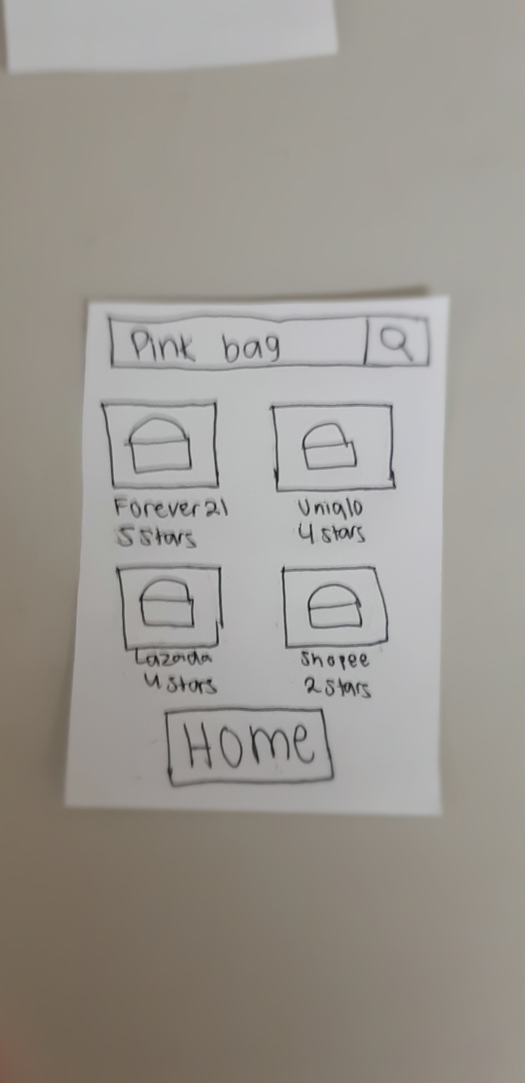
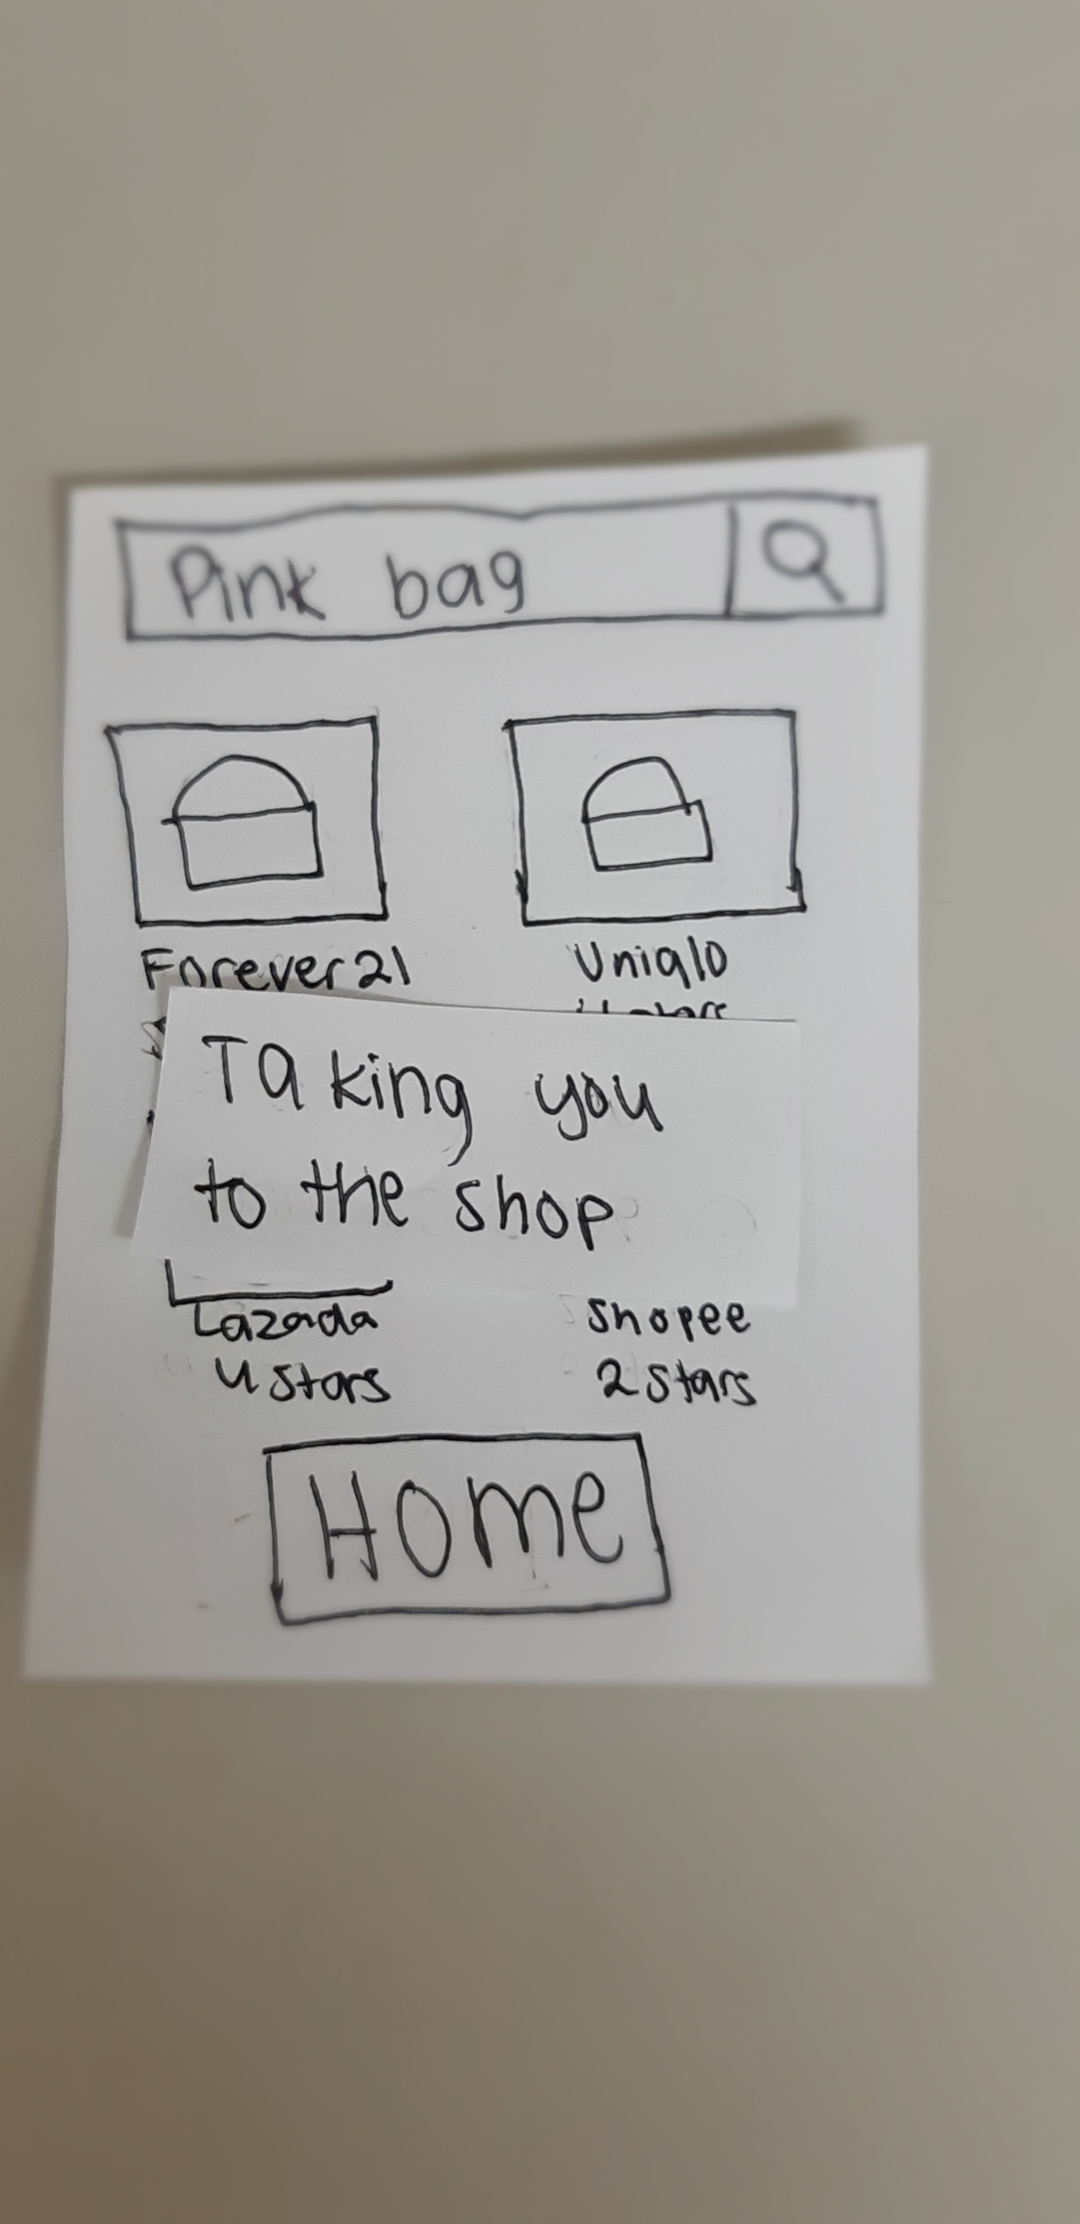
Paper Prototype 1

Slide 15
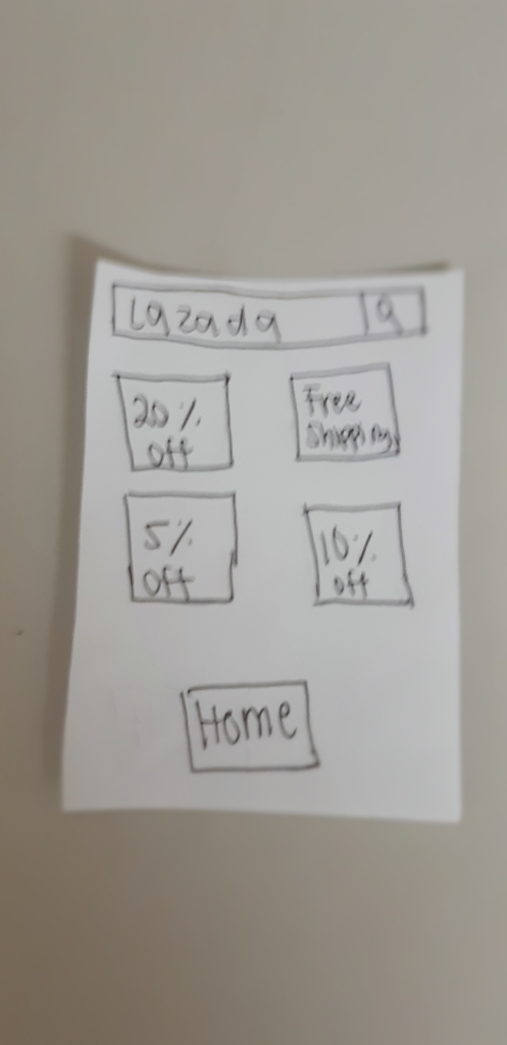
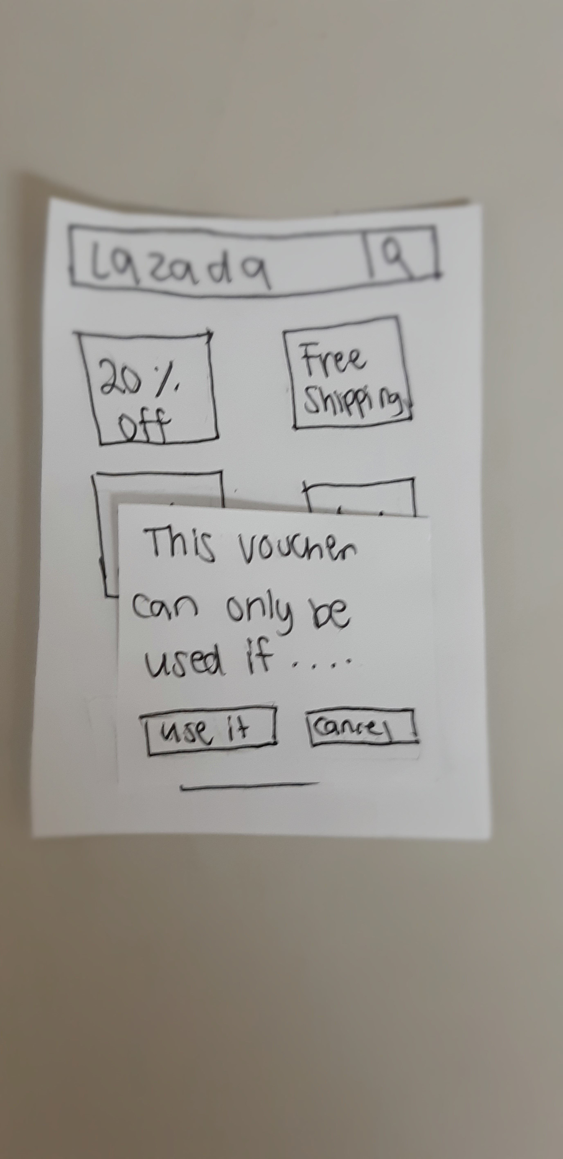
Paper Prototype 1

Slide 16
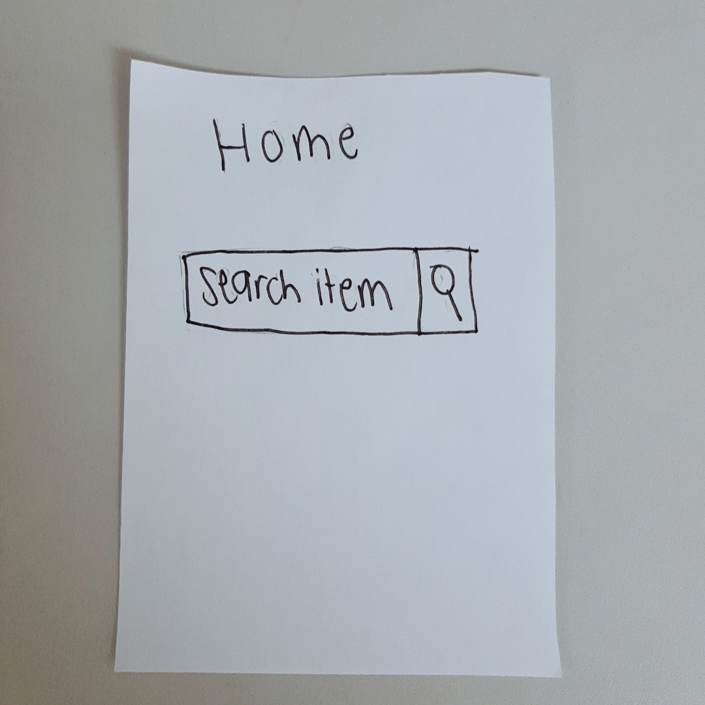
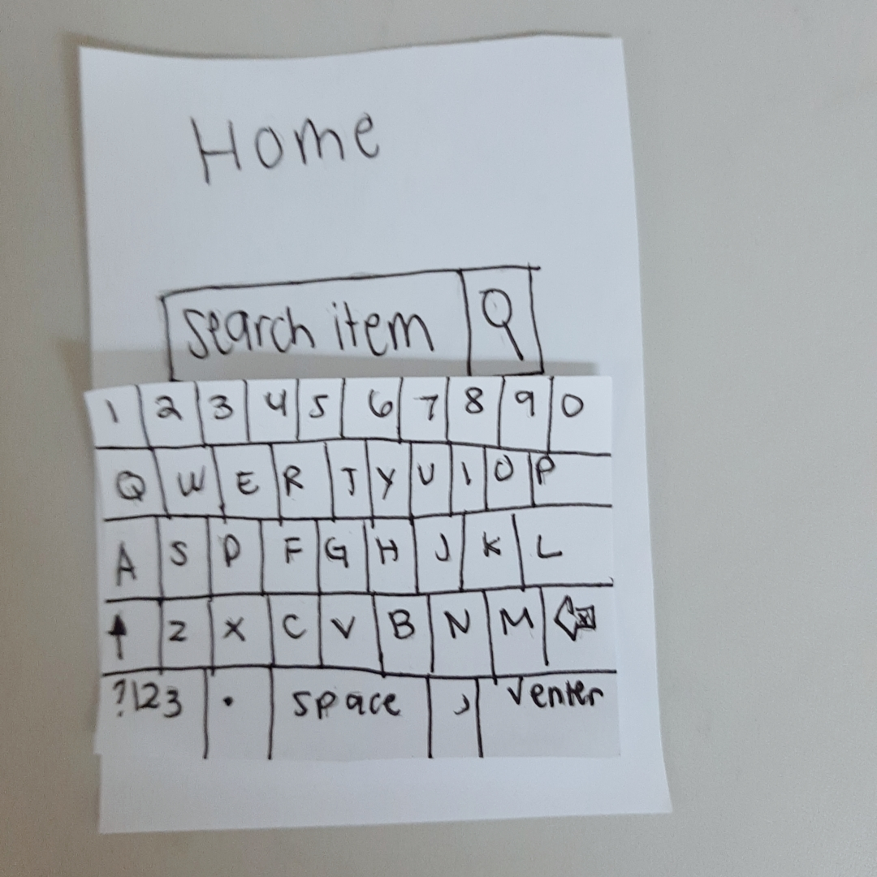
Paper Prototype 2

Slide 17
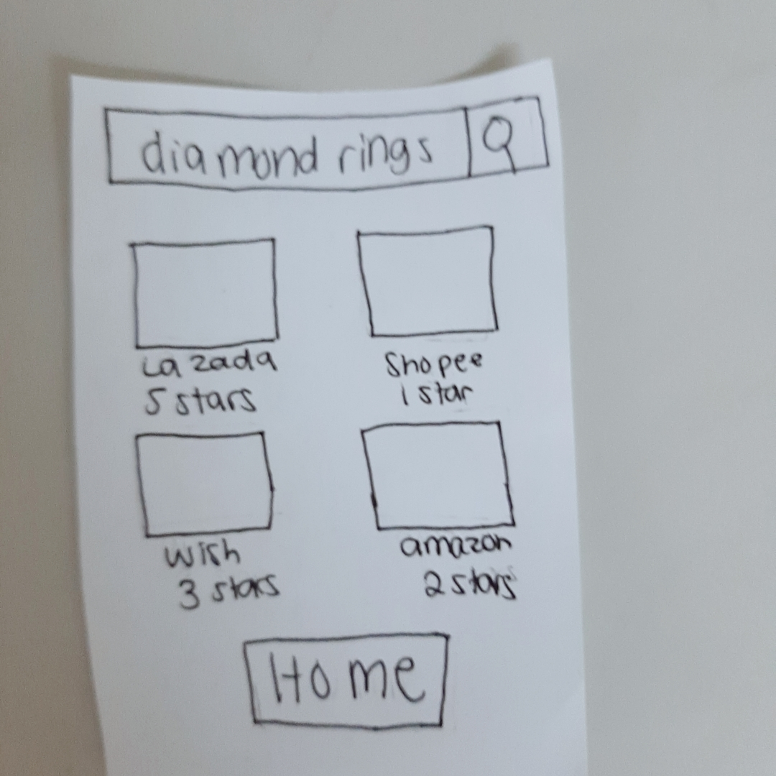
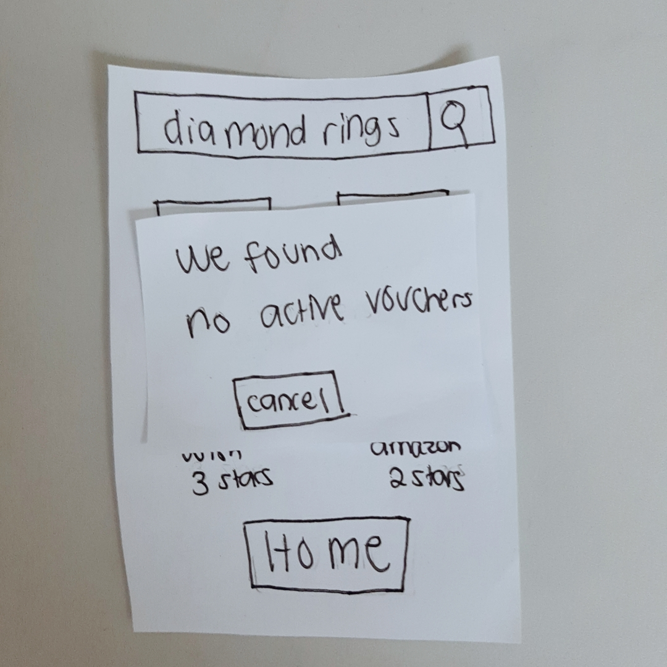
Paper Prototype 2

Slide 18
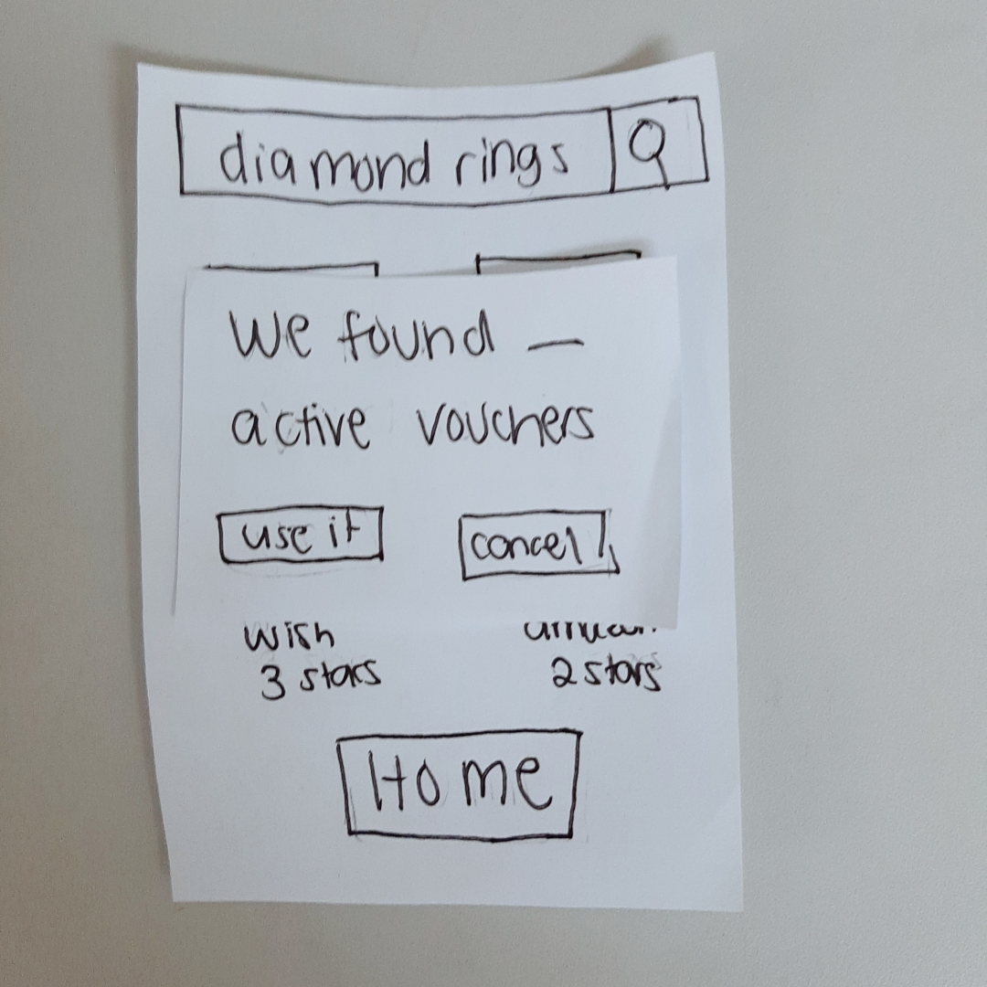
Paper Prototype 2

Slide 19
Recommendations and Remarks
Jaques Earnest Philip Ramos– APC Student
Needs a filter to arrange it by price, shop, or star rating/reviews.
Interface Is not confusing and straightforward, very easy to use.

Slide 20
Recommendations and Remarks
Kean Coria – APC Student
Search items and search vouchers are in the links or buttons (one search bar)
Voucher options should be integrated to the store gallery

Slide 21
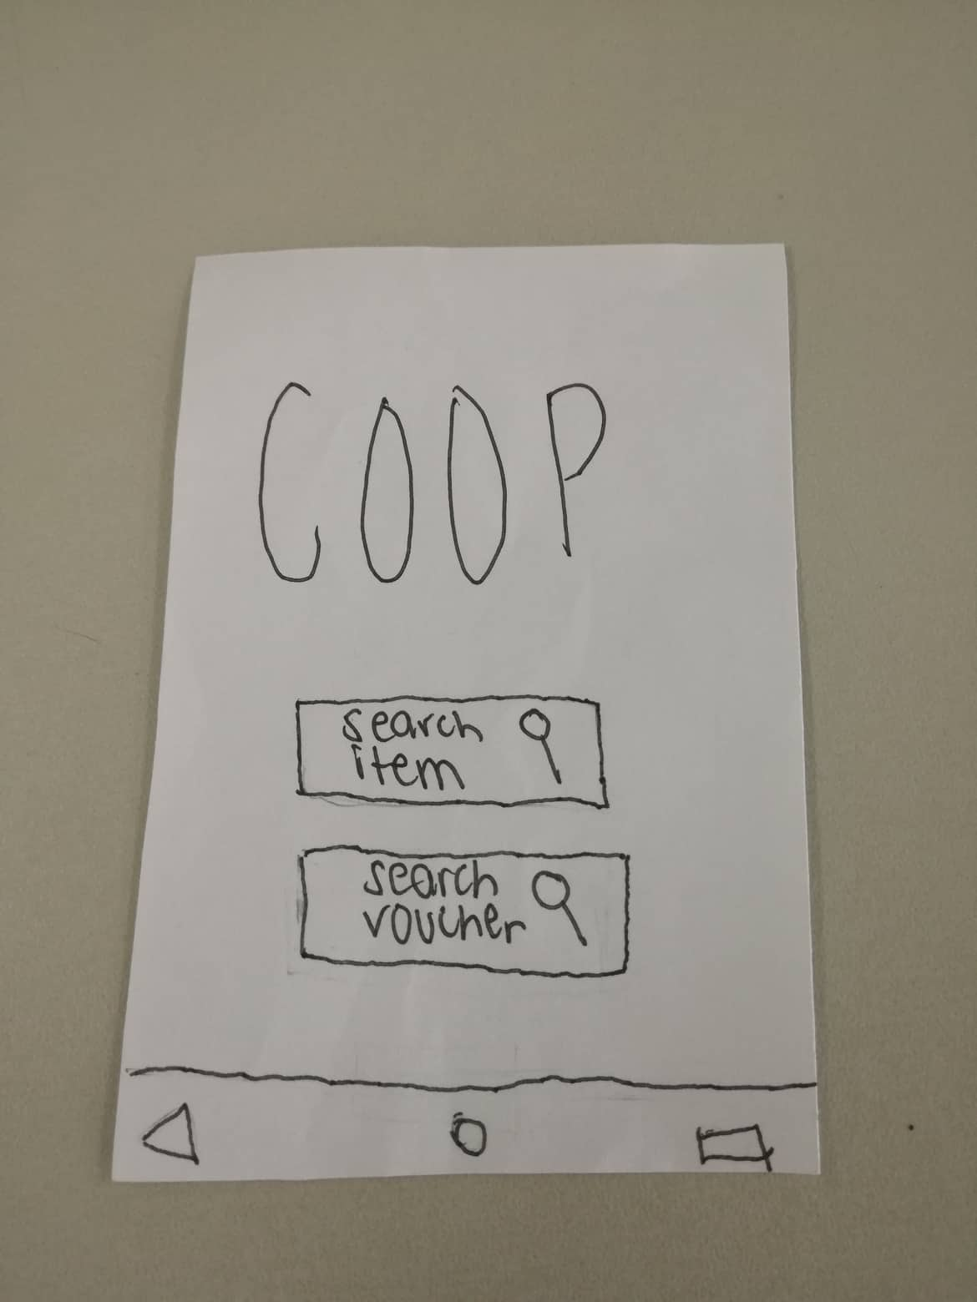
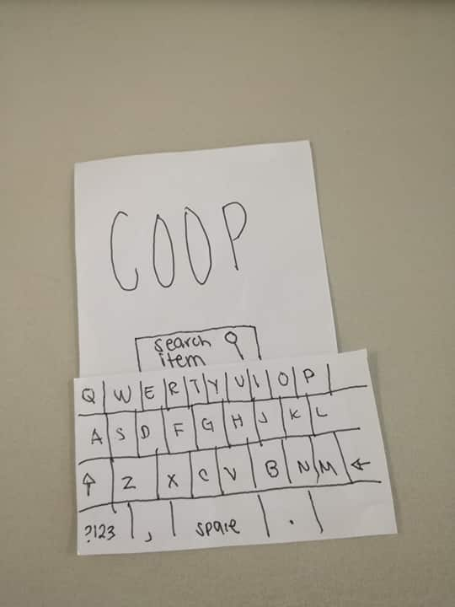
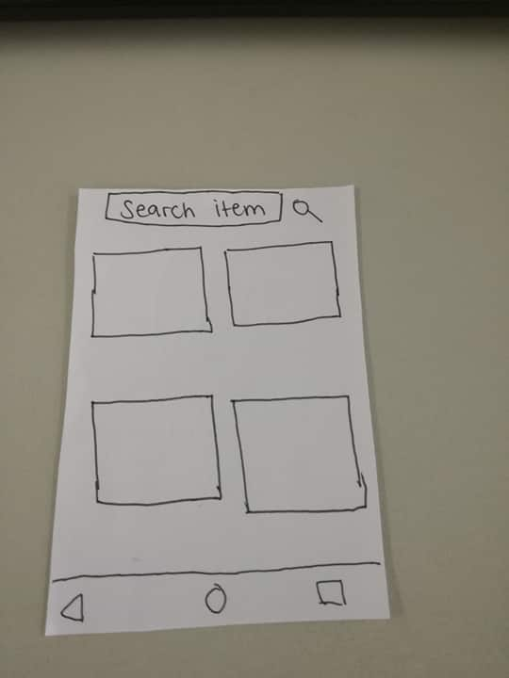
Final Paper Prototype
Search Item

Slide 22
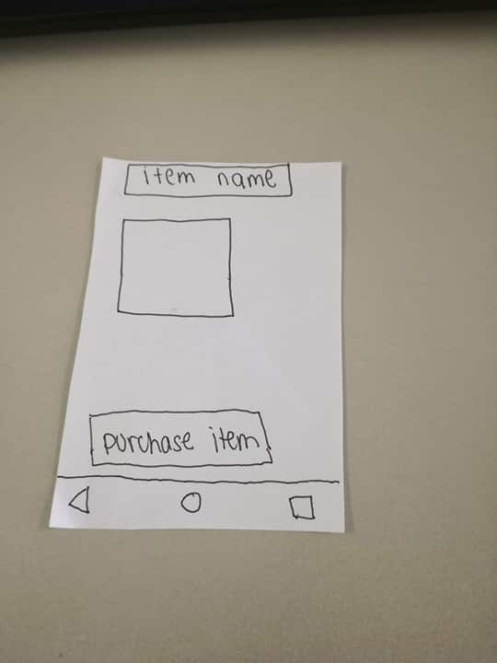
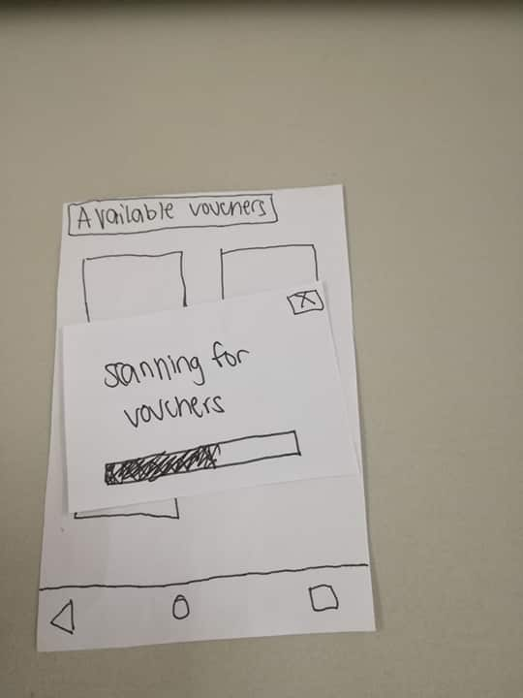
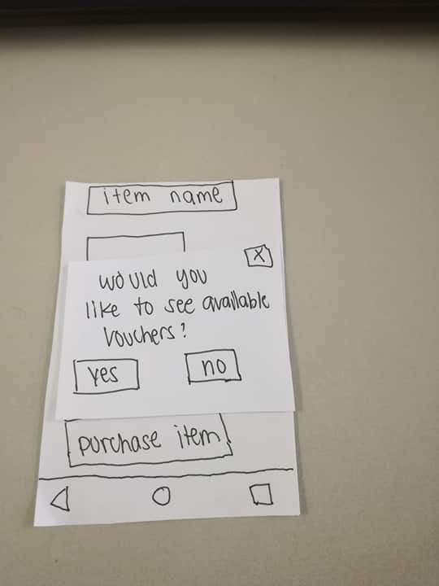
Final Paper Prototype
Search Item

Slide 23
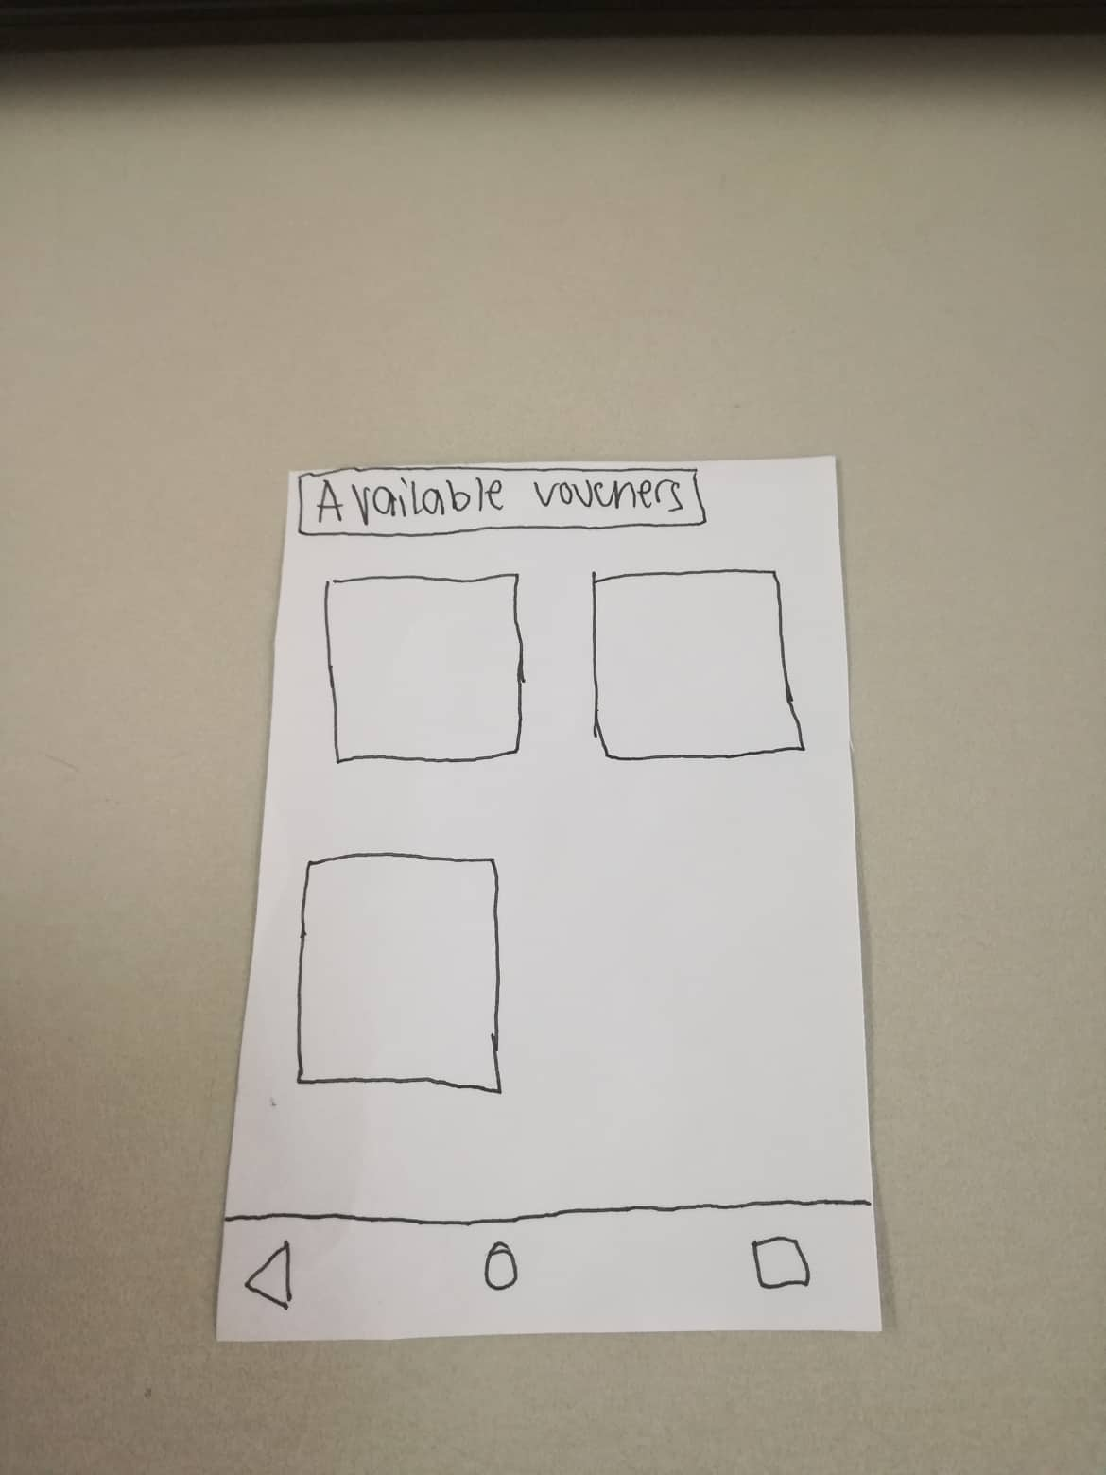
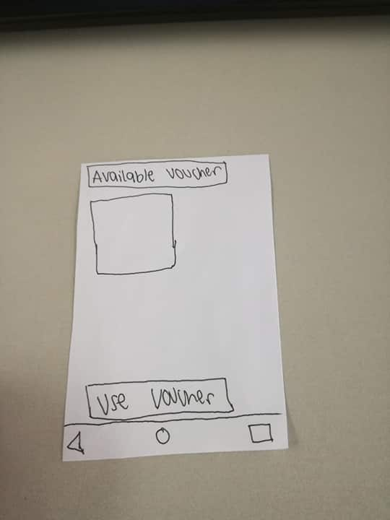
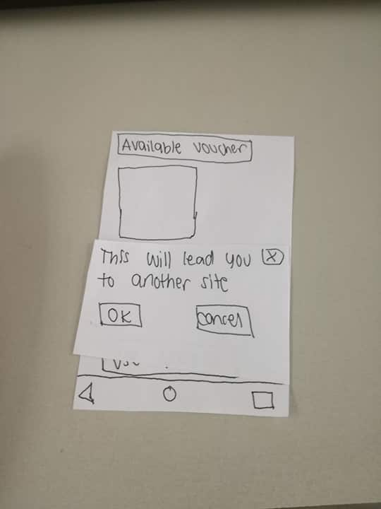
Final Paper Prototype
Search Item

Slide 24
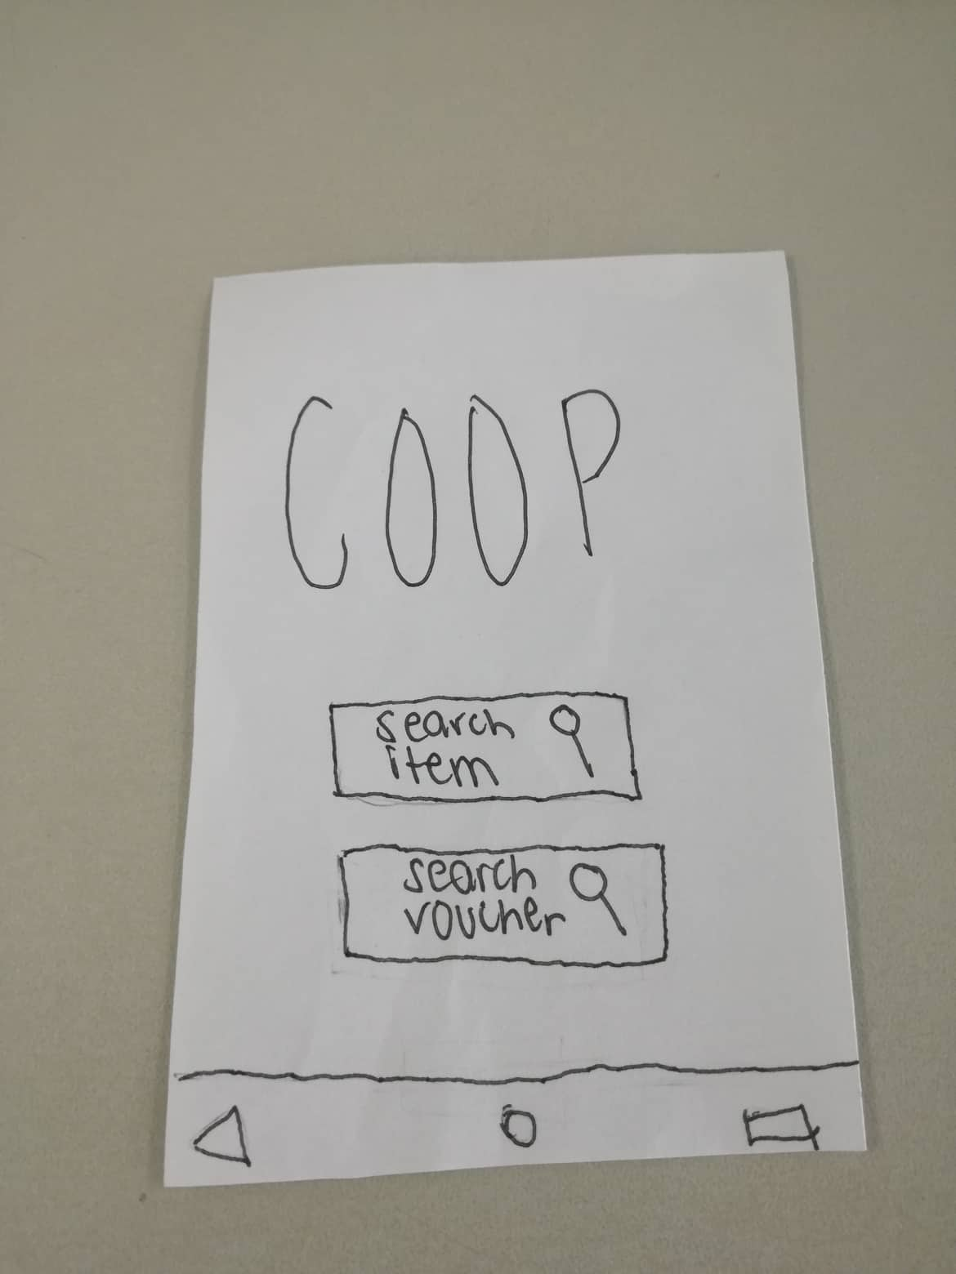
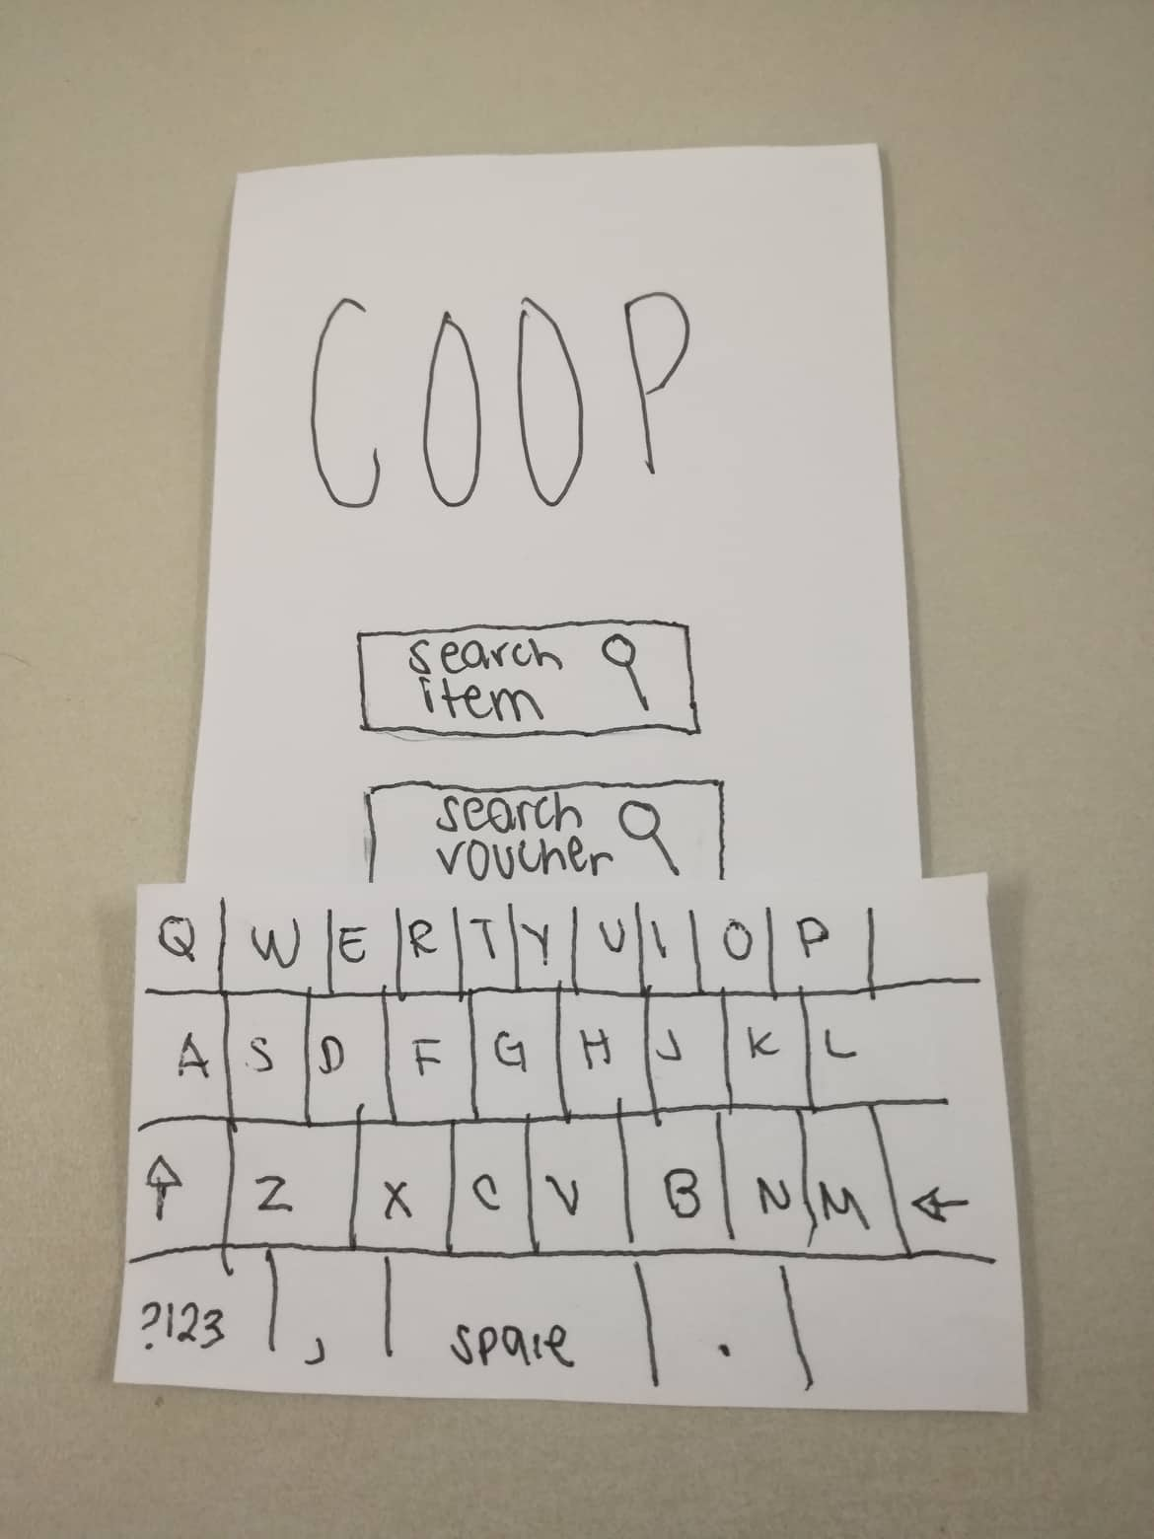
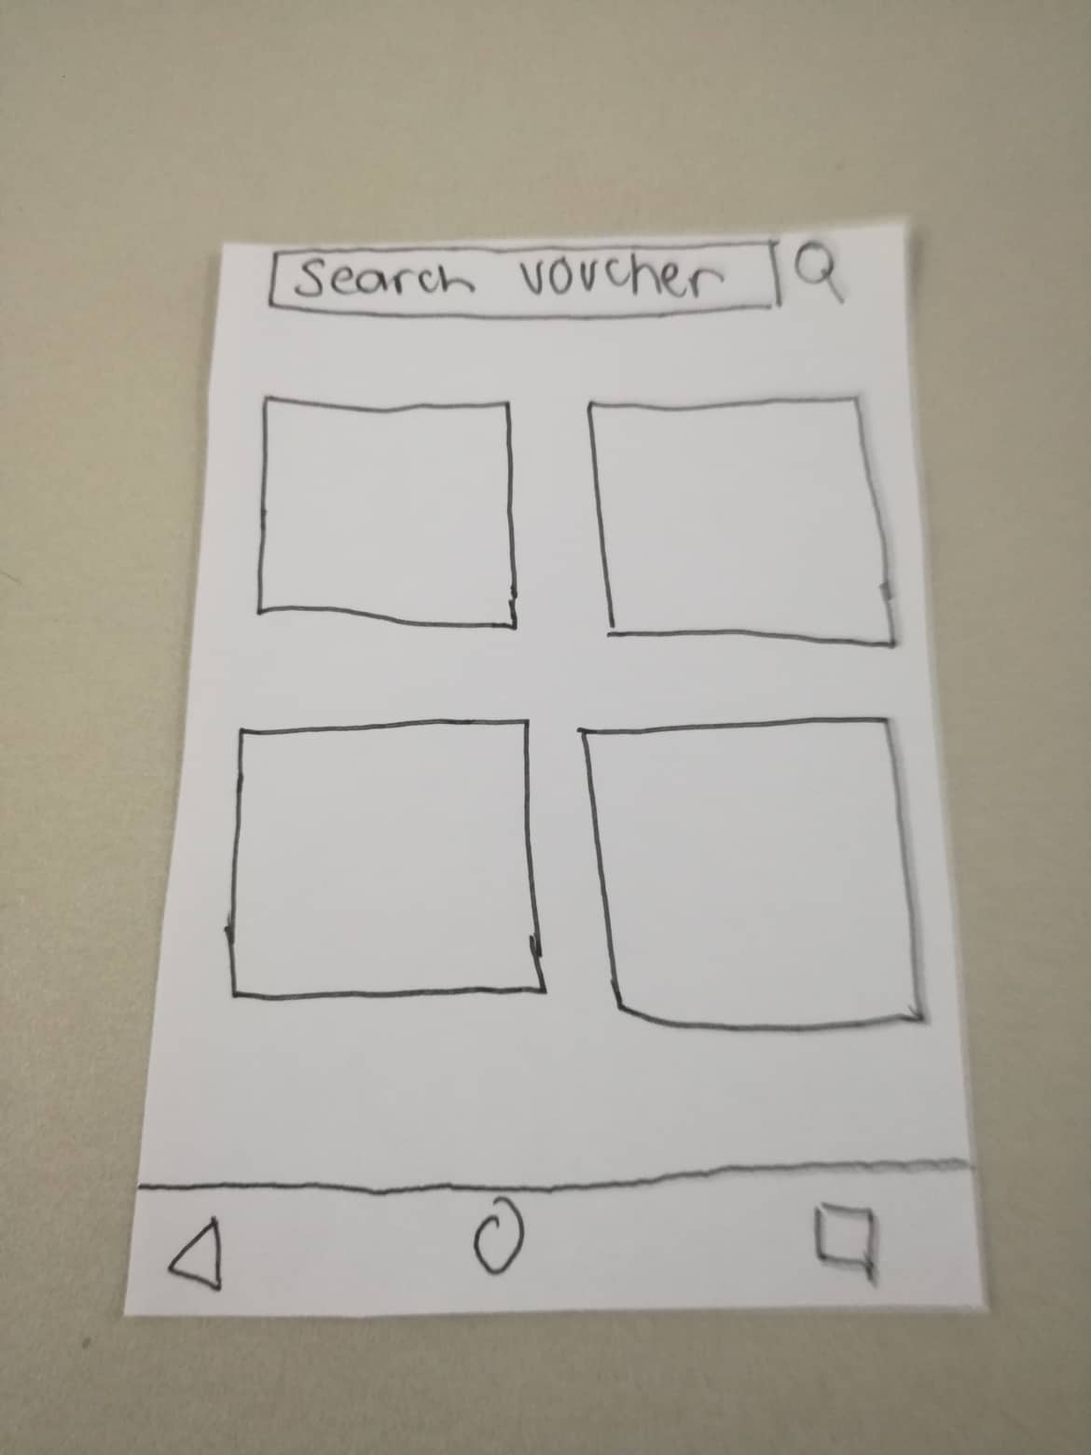
Final Paper Prototype
Search Voucher

Slide 25
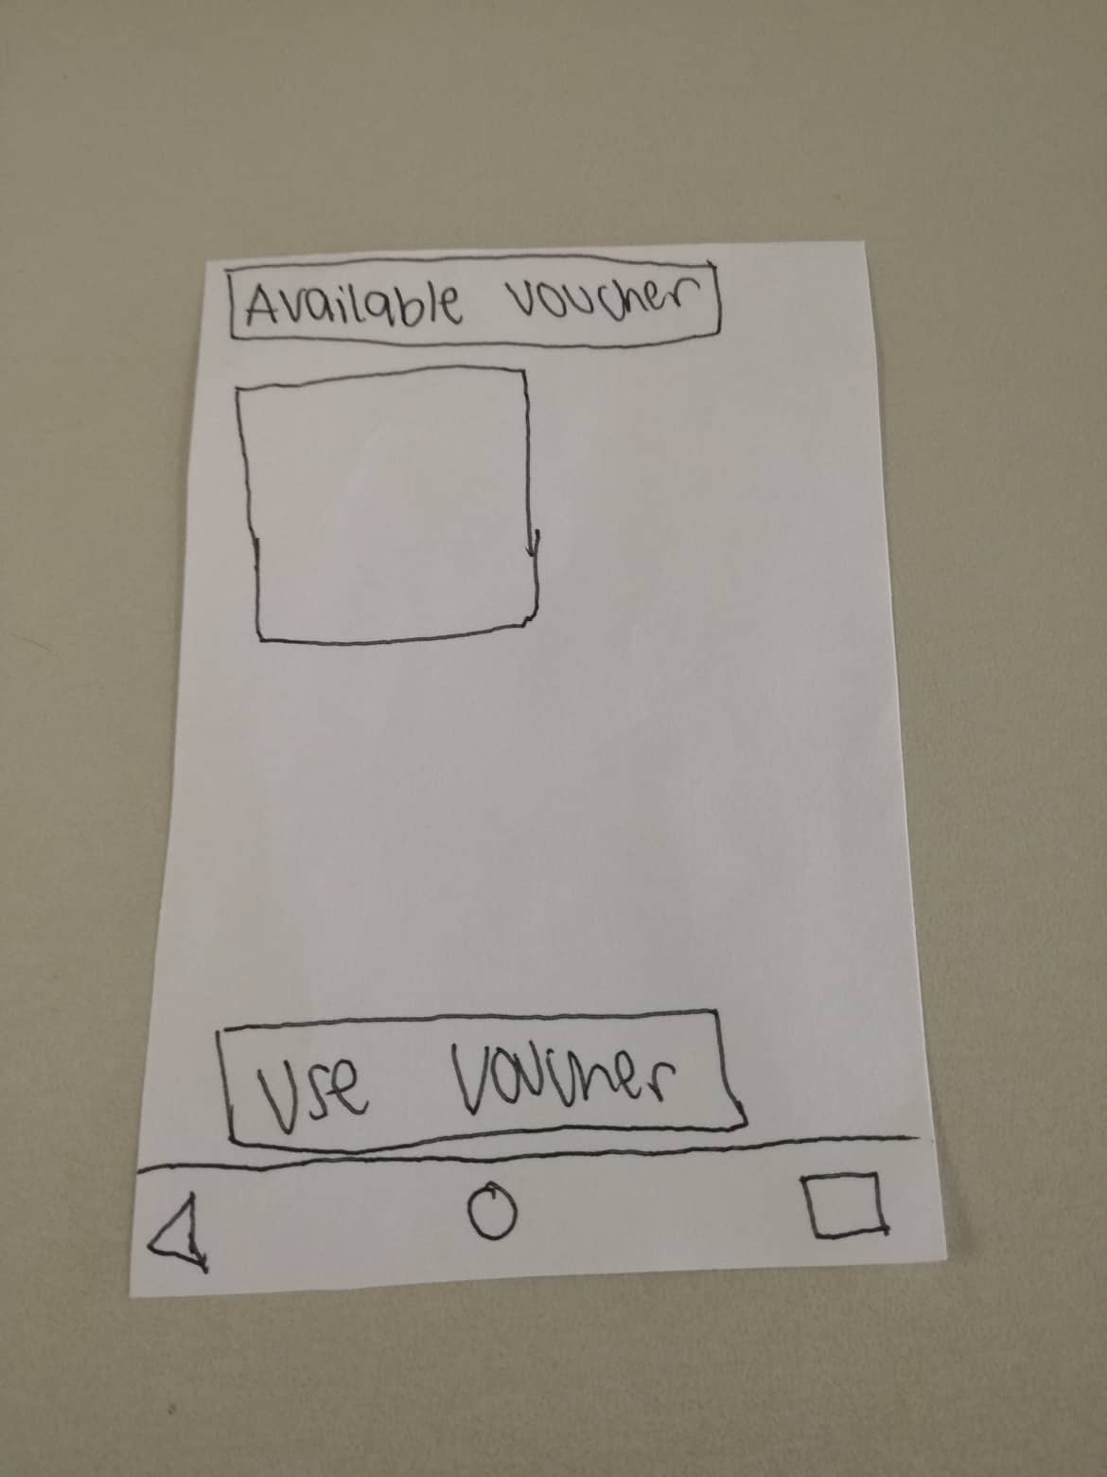
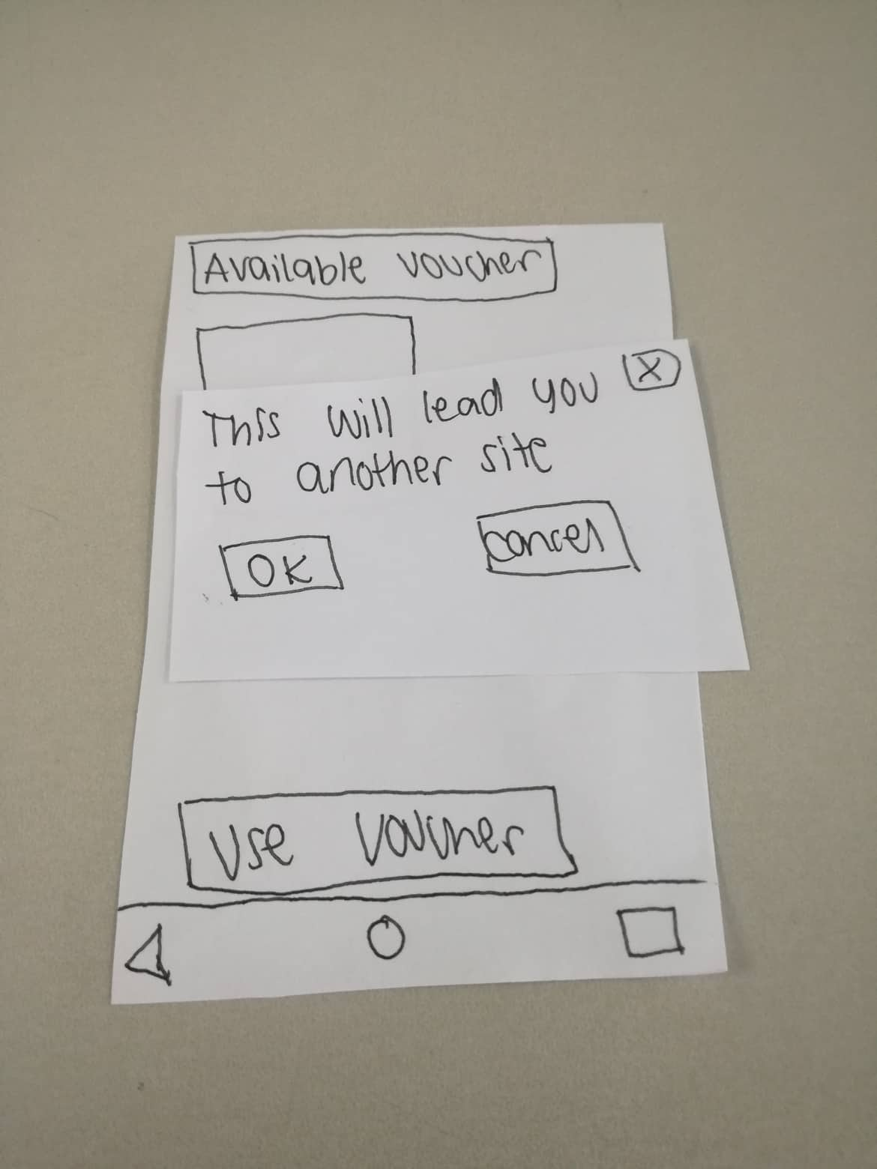
Final Paper Prototype
Search Voucher

Slide 26
Recommendations and Remarks
Kean Coria – APC Student
Much Improved! Better Interface.

Slide 27
Recommendations and Remarks
Jaques Earnest Philip Ramos– APC Student
The interface became smoother and easier to understand.
Added more filter options.
There is a working back button.

